Slide 1
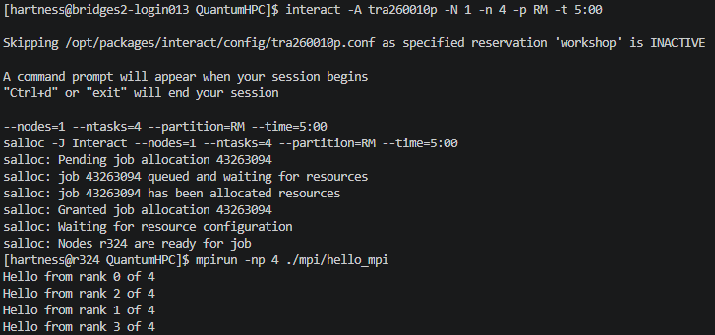
hello_mpi.c

Slide 2
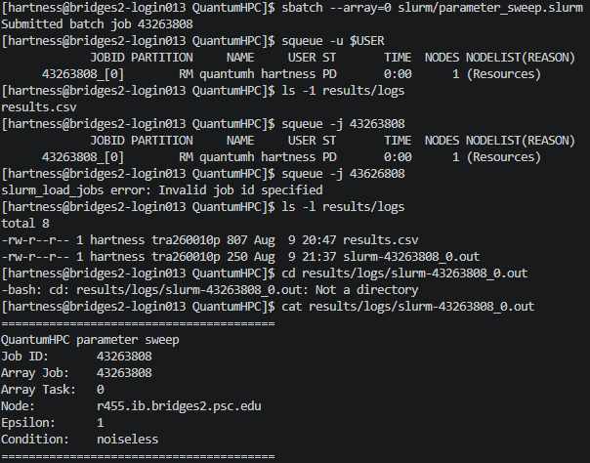
parameter_sweep.slurm
Notes:
Make sure you’re in the compute node when running actual experiment

